Slide 1


Slide 2

AGENDA
Mission & Problem Statement
ER Diagram
Tableau Applications

Slide 3

MISSION STATEMENT
Providing an efficient way for real estate agencies to manage their existing properties in order to assist home buyers in finding the ideal house based on the property characteristics they want.

Slide 4
PROBLEM STATEMENT
Continuous development of network technology
Aggregate & analyze all relevant data
HOWEVER...
Real estate businesses will generate more and more data
More opportunities to gain practical knowledge from data
There will be new applications for real estates
Operating
Leasing
Financing
Buying
In this data-driven age: too much unstructured data & fragmentized information are not being utilized
Disconnected information & data failed to provide the accurate overview of clients’ expection

Slide 5
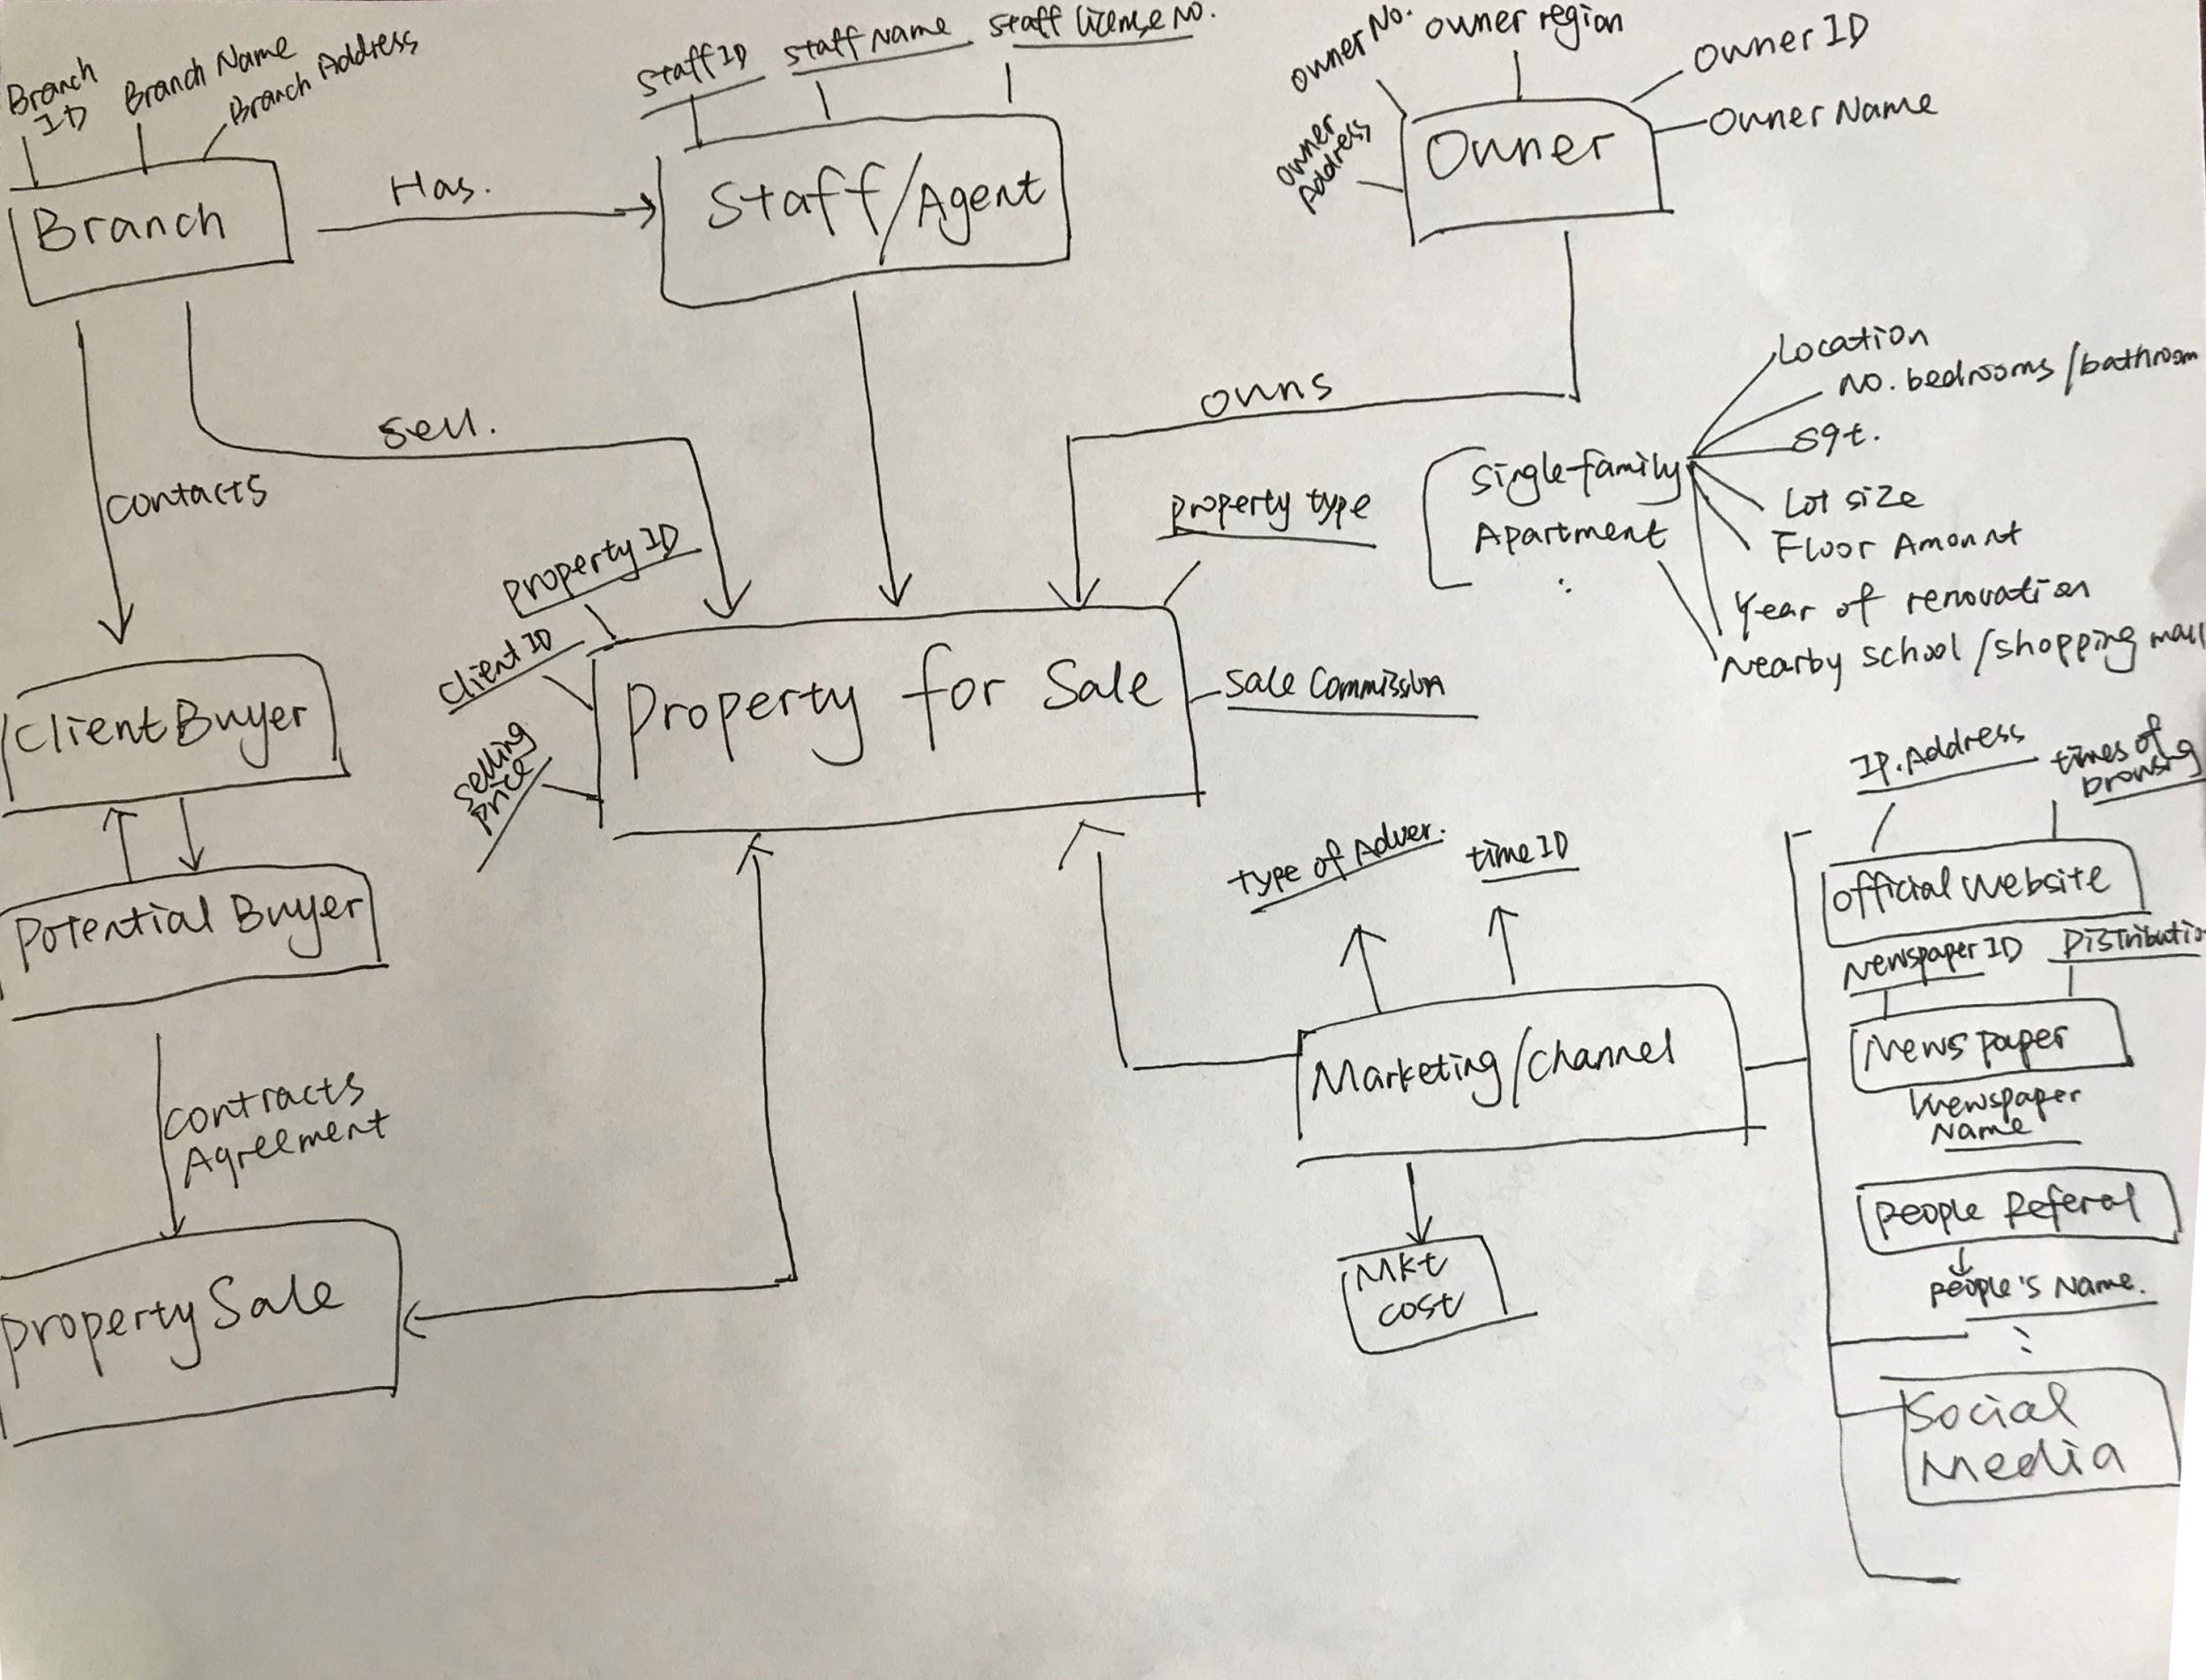

ER Diagram_Conceptual Model

Slide 6
Based on Conceptual Model...
01
Manages agents, collecting information,etc.
Predicting revenue and costs
Branches
02
Match properties based on buyers’ requests
Contact potential buyers:
Provide information and contract agreement
Agents
03
Listing the price, ID, type of property
Listing the related information of agents
Listing

Slide 7
Based on Conceptual Model...
04
Provide detailed information of their properties
How they want their properties to be advertised
Their ideal selling prices
Sellers
05
Provide the information of ideal properties
Discuss the price of property
Sign the contract agreement with agents
Buyers
06
Property Facts
Year Built
Year Renovated
Properties

Slide 8
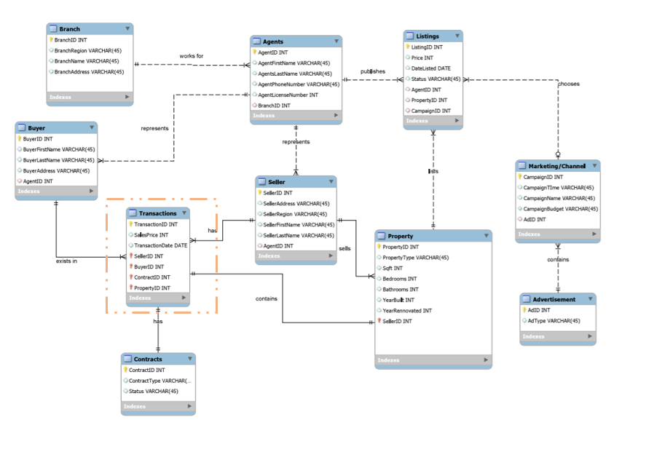
ER Diagram _ with Fact Table
Transaction table is actually the fact table here.

Slide 9
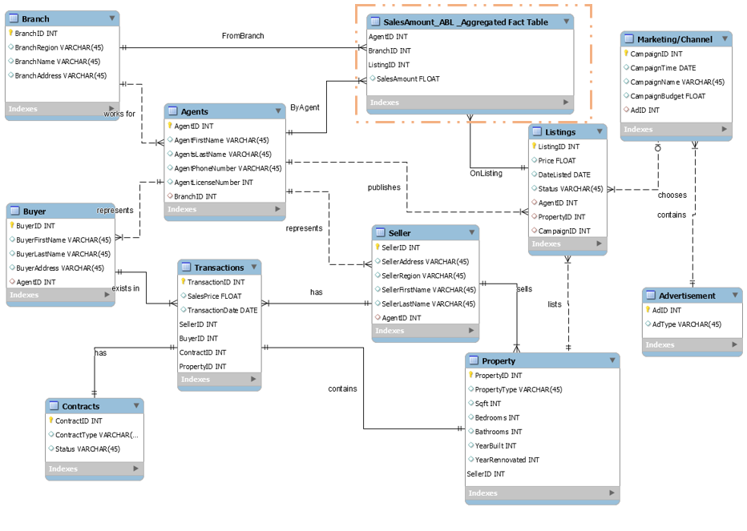
ER Diagram_with Aggregated Fact table
SalesAmount_ABL_Aggregated Fact Table
Providing summary of sales amount by a particular agent from a particular branch on a particular listing
Notes:
fact_SalesAmount_ABL_Aggregated fact table provides summary of sales amount by a particular agent from a particular branch on a particular listing.

Slide 10
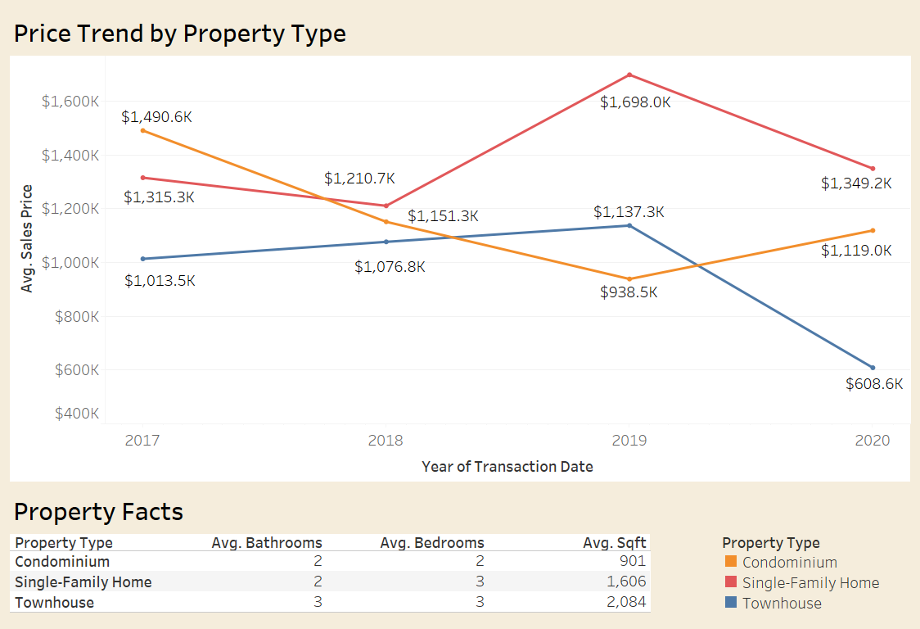
TABLEAU Application & Analysis
Housing Price Trend and Property Facts
Manage Property
Predict housing price
Notes:
https://public.tableau.com/profile/jiajie.xu#!/vizhome/try1_15840629867050/Dashboard1?publish=yes

Slide 11
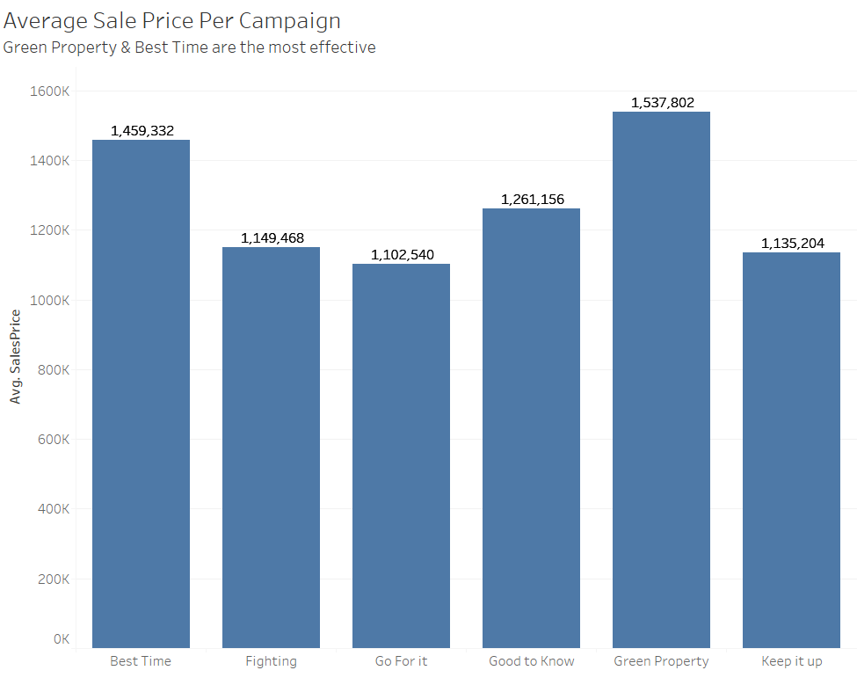
TABLEAU Application & Analysis
Listed are campaigns and its average sales.
What went right
What went wrong

Slide 12
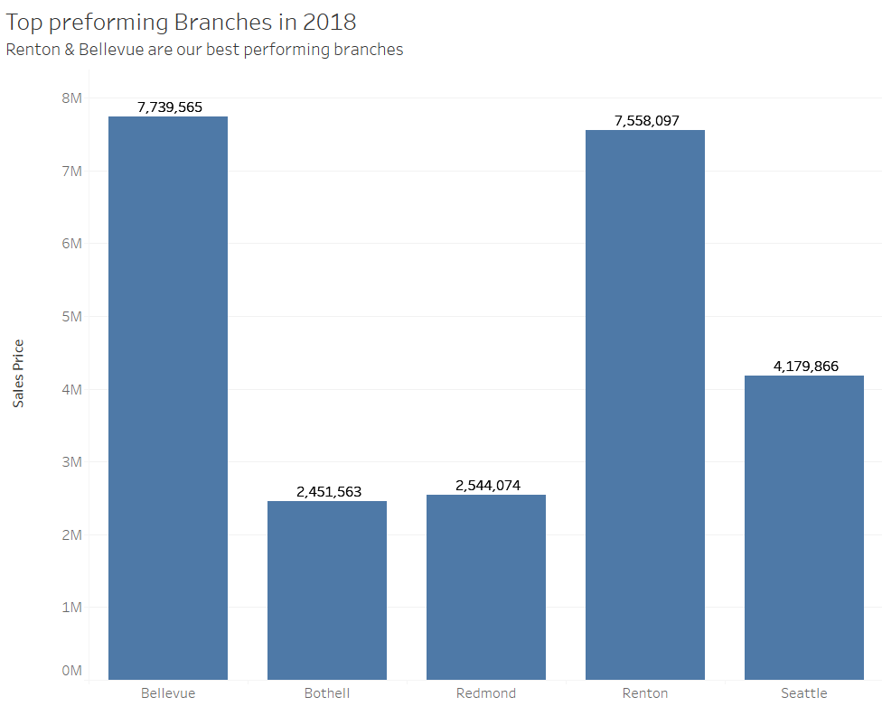
Tableau Application & Analysis
From our 5 branches, Renton and Bellevue had agents who sold highest amount in 2018.
Allocate more resources
Find out root causes of low sales

Slide 13


CONCLUSION
Benefits of New implementation:
Faster/Accurate Processing
Deeper understanding of the Business
Privacy & Security concerns covered
Redundancy removed
….Which all leads to… PROFIT

Slide 14

Thank you!
Any questions?

Slide 15
APPENDIX -QUERIES
1. Property Management
SELECT
YEAR(t.TransactionDate) TransYear,
p.PropertyType,
ROUND(AVG(t.SalesPrice), 2) AvgPrice
FROM
Property p,
Transactions t
WHERE
p.PropertyID = t.PropertyID
GROUP BY TransYear , p.PropertyType;

Slide 16
APPENDIX -QUERIES
2. Top Performing Campaigns
SELECT
m.CampaignName,
AVERAGE(l.SalesPrice) AS SalesPrice
FROM
MarketingChannel m,
Listings l
WHERE
m.CampaignID = l.CampaignID
GROUP BY l.CampaignID

Slide 17
APPENDIX -QUERIES
3. Top Performing Branches
SELECT
b.BranchRegion, SUM(SalesPrice)
FROM
Branch B,
Listings l,
Agent A
WHERE
A.AgentID = b.AgentID
AND
A.AgentID = L.AgentID
GROUP BY b.BranchRegion

